Slide 1
REGIONAL DISPARITY OF SERVICE SECTOR EMPLOYMENT

Slide 2
Submitted By
KABERI DUTTA
upervisor: Anupam Hazra
Assistant Professor
University of Kalyani

Slide 3
INTRODUCTION
India’s service sector covers a wide variety of activities that have different features and dimentions.
They include trade, hotel and restaurants, transport, storage and communication, financing, insurance, real estate and business services, community, social and personal services and services associated with construction.
Services in India are emerging as a prominent sector in terms of contribution to national and states incomes, trade flows, foreign direct investment(FDI) inflows and employment.

Slide 4
REVIEW OF LITERATURE
Arpita Mukherjee (): " The service industry, which has the highest labour productivity and is expected to continue rising quickly, is the largest and fastest-growing sector in India. India lacks an inclusive growth strategy, and the proliferation of governing organisations and a lack of coordination among them harm the sector's development.
The straightforward quantitative model does demonstrate that TFP growth can duplicate the output sectoral composition, making it a better candidate to assess the dynamic performance of the model (Rubina Verma).
In Donghoon Lee and Kenneth L. Woolpin's paper, a dynamic optimization model is applied to estimate the determinant of the growth in the service sector resulting from technological change and factor and product price changes.
Arup Mitra () while studying the impact of trade liberation on service sector employment. The effect of trade liberalization on the service sector Skill upgradation and human capital formation in the rural areas will enable the rural youth to take advantage of these new opportunities.
Raja Mikael Mitra () Typically, sustainable, inclusive social and economic development is based on developing service sectors and the interface between them because services like education, healthcare, banking, legal systems, ICT, and logistics are fundamentally important for goods-producing sectors.

Slide 5
OBJECTIVE
To check the state wise effectiveness of rural urban , male female , age difference, education, marital status employment generating in number.
To check the regional wise effectiveness of rural urban , male female , age difference, education, marital status, generating employment in number.

Slide 6
DATA SOURCE AND METHODOLOGY
The paper is based on the analysis of the secondary data which were collected from NSSO employment unemployment survey data, unit level 68 round. Secondary data’s have been analysed with the help of charts and diagram.
Here we are used cross section analysis.

Slide 7
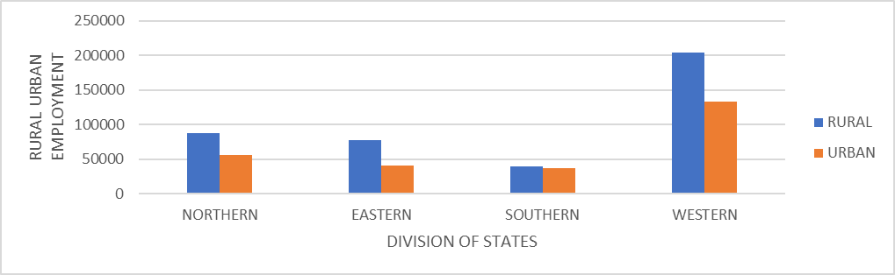
REGIONAL DIFFERENCES OF RURAL URBAN EMPLOYMENT GENERATING IN NUMBER

Slide 8
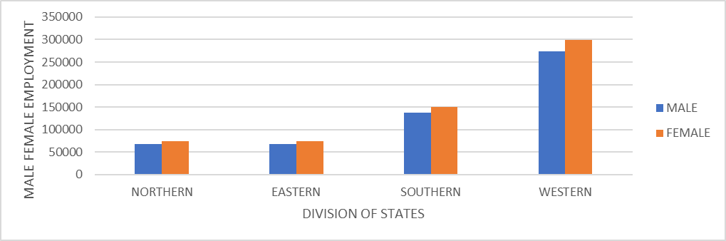
REGIONAL DIFFERENCES OF MALE FEMALE EMPLOYMENT GENERATING IN NUMBER

Slide 9
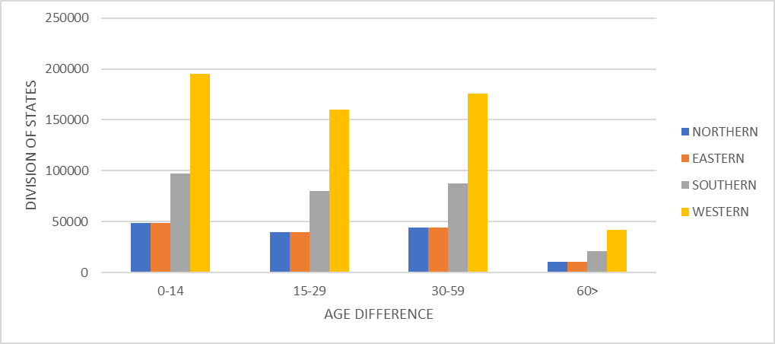
REGIONAL DIFFERENCES OF AGE DISPARITY GENERATING IN NUMBER

Slide 10
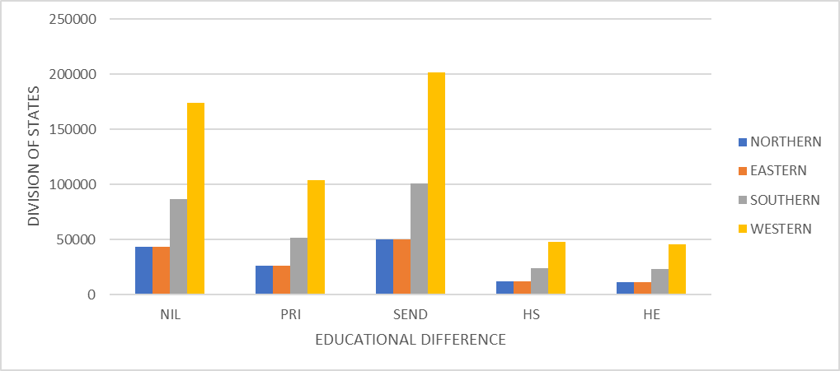
REGIONAL DIFFERENCES OF EDUCATION BASED ON EMPLOYMENT GENERATING IN NUMBER

Slide 11
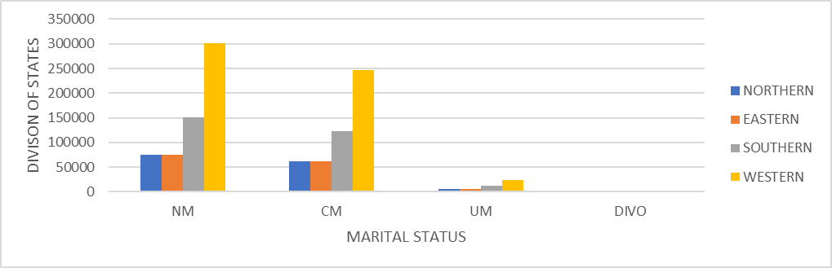
REGIONAL DIFFERENCES OF MARITAL STATUS BASED ON EMPLOYMENT GENERATING IN NUMBER

Slide 12
RESULT IN ANALYSIS
For rural urban employment in northern region we see that for rural, HIMACHAL PRADESH(80%) is higher and for urban, Delhi(93%) is higher than all other states.
For rural urban employment in Eastern region we see that for rural, Assam(77%) is higher and for urban, Mizoram(64%) is higher than all other states.
For rural urban employment in southern region we see that for rural, Kerala (58%) is higher and for urban, Karnataka(52%) is higher than all other states.
For rural urban employment in western region we see that for rural, Rajasthan(61%) is higher and for urban, Goa(64%) is higher than all other states.
In western region rural urban employment is very high and in southern countries rural urban ratio is very low in compare to the other three regional countries.
For male female employment in northern region we see that for male, Sikkim (54%) is higher and for female, Punjab(55%) is higher than all other states.
For male female employment in Eastern region we see that for male, Manipur(50.46%) is higher and for female, West Bengal (54%) is higher than all other states.
For male female employment in southern region we see that for male, ANDHRA PRADESH (49%) is higher and for female, Kerala(52.27%) is higher than other states.
For rural male female in western region we see that for male, MAHARASHTRA (49%) is higher and for female, GUJARAT (53%) is higher than all other states.
Male female ratio is again high in western region and low in northern region.
For northern region UP is higher(39%) for 0-14 and Delhi is higher(29.57%)for 15-29 age group and Delhi is higher(36%) for 30-59 age group and Punjab is higher(9.43%) for 60> age compare to others states.
For eastern region Bihar is higher(40%) for 0-14 and Nagaland is higher(33%)for 15-29 age group and West Bengal is higher(37%) for 30-59 age group and CHATTISGARH is higher(6%) for 60> age compare to others states.
For southern region ANDHRA PRADESH is higher(30%) for 0-14 and Andhra Pradesh is higher(27.97%)for 15-29 age group and KERALA is higher(4%) for 30-59 age group and Kerala is higher(13%) for 60> age compare to others states.
For western region RAJASHTAN is higher(35%) for 0-14 and MAHARASHTRA is higher(29%)for 15-29 age group and Goa is higher(41%) for 30-59 age group and Goa is higher(11%) for 60> age compare to others states.
Now we see the age ratio differences in the four region and we can state that the 0-14 age group is very active in four regions and 60> group is inactive in four region.

Slide 13
RESULT IN ANALYSIS
For educational differences in northern region UP is high(38%) for NIL,MP is higher(20%) for PRI,MP is high(37%) for SEC , Delhi is high(13%) for HS, Delhi is high(21%) for HE in compare to all the other states.
For educational differences in eastern region Bihar is high(32%) for NIL , Bihar is higher(23%) for PRI, Mizoram is high(57%) for SEC , Nagaland is high(16%) for HS, Nagaland is high(14%) for HE in compare to all the other states.
For educational differences in southern region ANDHRA PRADESH is high(30%) for NIL , Karnataka is higher(16%) for PRI, Kerala is high(53%) for SEC , Kerala is high(13%) for HS, Kerala is high(9%) for HE in compare to all the other states.
For educational differences in western region RAJASHTAN is high(34%) for NIL ,RAJASHTAN is higher(20%) for PRI, MAHARASHTRA is high(43%) for SEC , GOA is high(16%) for HS, GOA is high(11%) for HE in compare to all the other states.
Now we see that the educational status, we can state that the secondary education in western, participation is very high in all the regions and HE participation in northern region is very low in all the four region.
Now we see that the marital status, we can state that the non married employment in western region is high in compare to the other three status in four region and divorce is very low in all the four region.

Slide 14
CONCLUSION
From above analysis we can conclude that participation of people in service sector of western region is always higher than others regions.
We can also see that for every change in % of employment generating for service sector growth is differ from every state wise and region wise.
So that we concluded, our main motive of the paper is full filled for every states of conditions. Regional disparity and state wise disparity is our main motive to our paper.

